Slide 1
Adolescents and Family HIV/AIDS
Supporting Success for Africa’s Next Generation
Professor Lucie Cluver
Oxford University & University of Cape Town
No conflict of interest to disclose

Slide 2
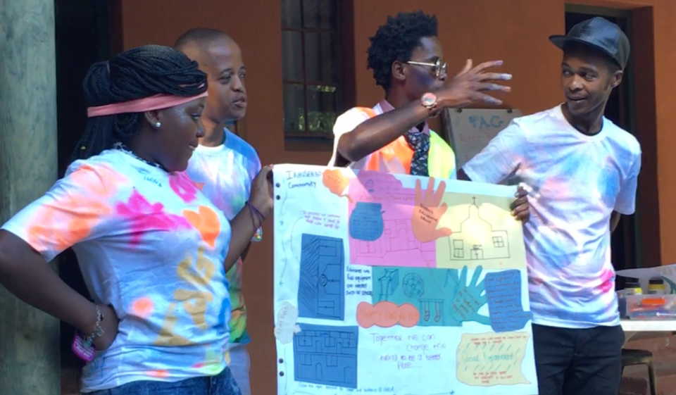
teen advisory groups:
South Africa, Uganda, Sierra Leone

Slide 3
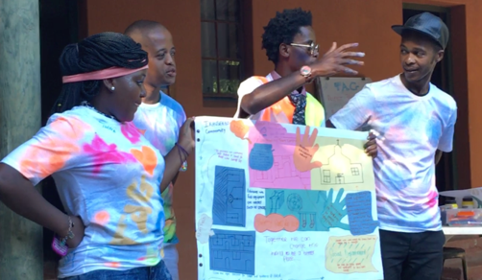
National survey (n=6000 adolescents, 2500 caregivers)
Ethics
Universities of Cape Town, Oxford, KwaZulu-Natal,
6 Provincial Health & Education Departments
Social & health referrals
Longitudinal survey
Age: 10-18
3 provinces South Africa
Stratified random sampling of census EAs
Every household with a child aged 10-17
97% follow-up in 2 provinces
45% AIDS-affected
Teen Advisory Group
Measures
Standardised scales
School, sex, mental health,
Family, fun, violence…
Cluver, L, Orkin, M, Boyes, M et al (2013). Social Science and Medicine.

Slide 4
Family AIDS-illness predicts child education difficulties
Cluver, Operario, Lane, Kganakga (2012). Journal of Adolescent Research

Slide 5
Family AIDS-illness and child hunger
Cluver, L, Gardner, F & Operario, D (2009). AIDS Care 21 (6) 732-741

Slide 6
Family AIDS-illness and child stigma
Cluver, L, Gardner, F & Operario, D (2008) J. Adolescent Health 42 (4) 410-418

Slide 7
South Africa, Malawi, Zambia (n=989)
Sherr L et al (2016). PlosOne.

Slide 8
Cluver, Orkin, Boyes, Sherr (2015) J Adol Health

Slide 9
Why do teenage girls have sugar daddies? (n=1400)
Cluver, Orkin, Boyes, Meinck, Makhasi (2011). JAIDS

Slide 10
Pathways to adolescent risks
mean χ²(679) | Bollen-Stine | mean χ²/df | RMSEA | SRMR | CFI | TLI
640.06 | p=.001 | 1.57 | .032 | .044 | .939 | .930
AIDS-orphan
Stigma
.13
Education risks
.43
.12
.18
.32
ABUSE
Psych.
distress
.72
.14
.08
.15
.15
HIV Risk Behaviour
.15
.24
.10
AIDS-sick parent
Poverty
.22
Cluver, Orkin, Boyes, Sherr, Nikelo, Makhasi (2013). Soc. Sci & Medicine. Analyses funded by RIATT.

Slide 12
Social protection reduces girls’ HIV risk (n=3500)
No cash transfer
Child cash transfer
Cluver, Boyes, Orkin, Pantelic, Molwena, Sherr (2013). The Lancet Global Health.

Slide 13
Cash + care reduces adolescent HIV risk incidence (n=3500)
Cash alone: OR .63
Cash plus care: OR .55
Cash alone: no effect
Cash plus care: OR .50
Cluver, Orkin, Boyes, Sherr (2014). AIDS.

Slide 14
Cash + care improves cognitive outcomes
Associations between social protection access and difficulties in remembering (F(3)=3.99, p=.008), learning (F(3)=9.92, p<.001), and comprehension (F(3)=1.68, p>.05)
Sherr, L, Macedo, A, Tomlinson, M et al 2017. BMC Pediatrics

Slide 15
Community-Based Organisation: improved outcomes
OR: .11***
Abuse
OR: .22**
Domestic violence
OR: .41*
Suicidal ideation
CBO contact
B: -.40*
Depression
B: -.40***
Stigma
B: -1.08***
Peer problems
B: -.77***
Conduct problems
B: 1.40***
Prosocial behaviour
Sherr L et al (2016). PlosOne.
Notes:
The second questions was: is CBO attendance associated with better outcomes?
Children who were in contact with CBO since 2012 showed better outcomes compared to the non-attenders. These effects persisted over time.

Slide 16
RCT: Psychosocial support increases disclosure & testing
RCT South Africa
428 HIV+ mothers
Children aged 6-10
PI: Rochat, T
Disclosure support program for mothers
Increased disclosure to children x10
Increased child healthcare access x27
Increased care and guardianship plans x3
Rochat, T, Stein, A, Cortina-Borja, M, Tanser, F, Bland, R (2017) Lancet HIV.

Slide 17
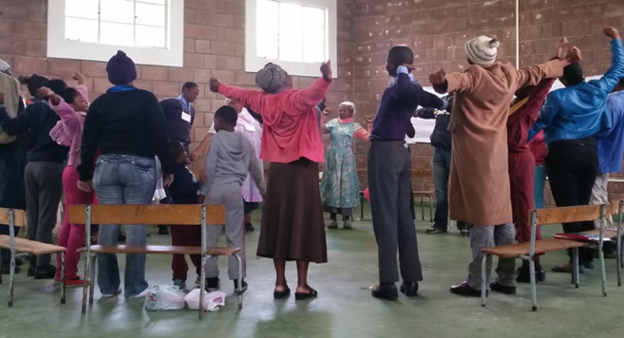
Parenting + economic empowerment
Cluver, L, Meinck, F, Steinert, J,
et al (2018) BMJ Global Health.
Monitoring & praising teens
Family problem-solving
Family budgeting and saving
Safety planning
Positive effects | IRR/d (95% CI)
Less violence | IRR.55 (.4,.75)***
More positive parenting | d.25 (.03,.47)*
More involved parenting | d.86 (.64,1.1)***
Less poor supervision | d-.05 (-.7,-.03)***
Less corporal punishment | d.-46 (-.7,-.24)***
Less depression (carer) | d-.33 (-.5,-.11)**
Less parenting stress | d-.37 (-.6,-.15)***
Less alcohol/drug use (carer) | IRR.67 (.49-99)*
Less alcohol/drug use (teen) | IRR.55 (.33-93)*
More social support (carer) | d.31 (.09-.52)**
More planning to protect teens in the community | d.48 (.24-.72)***
Less shortfalls of food | d-.62 (-.8-.40)***
More family savings | d.31 (.09-.53)**
Local community members
trained by local NGO
40 villages & urban sites
Stratified cluster-randomised
9m follow-up

Slide 18
Economic empowerment: better adolescent outcomes
SUUBI RCT: 286 orphaned children/adolescents
SUUBI+ Cluster RCT: 702 adolescents LHIV, 39 clinics, Uganda
PIs: F Ssewemala, Mellins, C
Child Development Accounts (matched 1:1)
Mentorship,
financial literacy,
family microenterprise training
[Adolescent HIV care & treatment, adherence counselling]
Improved education
Lower sexual risk-taking
Improved mental health
Higher viral suppression (for ALHIV)
Bermudez, L, Ssewamala, F, Neilands, B, Lu, L, Jennings, L, Nakigozi, G, Mellins, C, McKay, M. (2018) AIDS & Behavior

Slide 19
Psychological support for bereaved adolescents reduces mental health distress
RCT of a bereavement support group
for adolescent females in South Africa
demonstrated significant improvements
in psychological health of participants:
Reduced maladaptive grief
Reduced depression
Lower caregiver-reported adolescent behavioural problems.
Thurman T. R et al (2017). The Lancet Global Health, 5(6), e604-14.
Method: 382 adolescents aged 13-17 years randomly assigned to receive the intervention or waitlisted for enrolment the following year. Survey data were collected from adolescents and their caregivers prior to the intervention and again at 3 months post-intervention.

Slide 20
How does cash + care work?
‘Cash’ social protection
B= -.08; p<.002
Structural deprivation
and family AIDS(2011)
B= -.14; p<.001
B= -.28; p<.001
HIV-risk behavior (2012)
Psychosocial problems
B= .15; p<.001
B= .24; p<.001
B= -.12; p<.001
‘Care’ social protection
Controlling for: baseline HIV-risk behavior, adolescent age, HIV-prevention knowledge, urban/rural location, child migration, no. children in the household, female primary caregiver, birth certificate.
Cluver, Orkin, Meinck,, Boyes, Sherr, L (2016) Journal of the International AIDS Society (JIAS)
Notes:
Amy – keep this one! Good to keep in
Add a slide on Tamsen Rochat’s RCT
Lorraine’s slides on CCS
Add something on access to services?

Slide 21
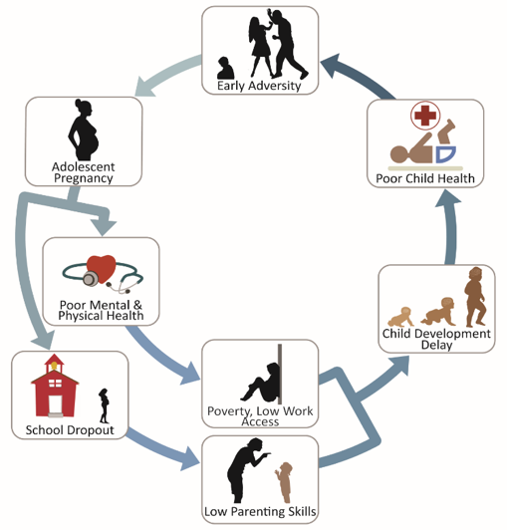
Africa in 2050: 60 million adolescent mothers 115 million of their children
What predicts their resilience against the odds?
Notes:
Move diagram to full

Slide 22
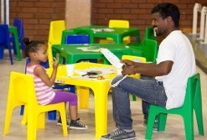
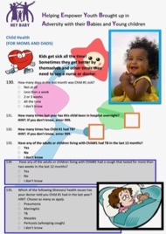
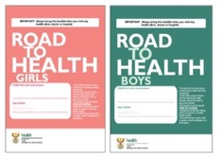
HEY BABY
Helping Empower Youth Brought up in Adversity with their Babies and Young children
Child development:
Mullen scales of early learning
Questionnaire 1:
Longitudinal quantitative survey data
Questionnaire 2:
Adolescent-parent & child caregiver questionnaire
Mother & child health data:
Child’s Road to Health book
Patient file
NHLS data
Figure 4. Adolescent parent questionnaire pre-piloted in 2017

Slide 23
Adolescent mothers living with HIV
Interaction effect of HIV x adolescent motherhood:
OR 5 p<03
10% 1-year incident pregnancy
17% do not know their child’s HIV-status
44% stopped ART when pregnant
23% mixed-feeding
68% ART-non-adherent in past 3 days

